Slide 1
Transcriptional noise of the glp operon in P. aeruginosa
Elisabeth Vatareck

Slide 2
Expression variability in P. aeruginosa PA14 based on 166 PA14 Tn mutant strains
expression threshold 3.0
glpD
threshold 0.6
common 0.265
Average log₂(CPM)
Notes:
… in this graph:
Here, each dot represents a value of transcriptional variation for each of the 6000 pa genes we mapped our dataset to, and it is plotted as a function of the average reads per gene
Yet most genes show a low variation below the average bcv of 0.265 which accounts for over 60 % of the genes
For highly variable genes we set a threshold at 0.6 and a minimum expression threshold at 3 log2 CPM (8 counts per million) in order to make sure not to include any technical noise
First question we addressed to this dataset, are there any trends in general among the gene functions that favor a higher or lower expression variability
6:01

Slide 3
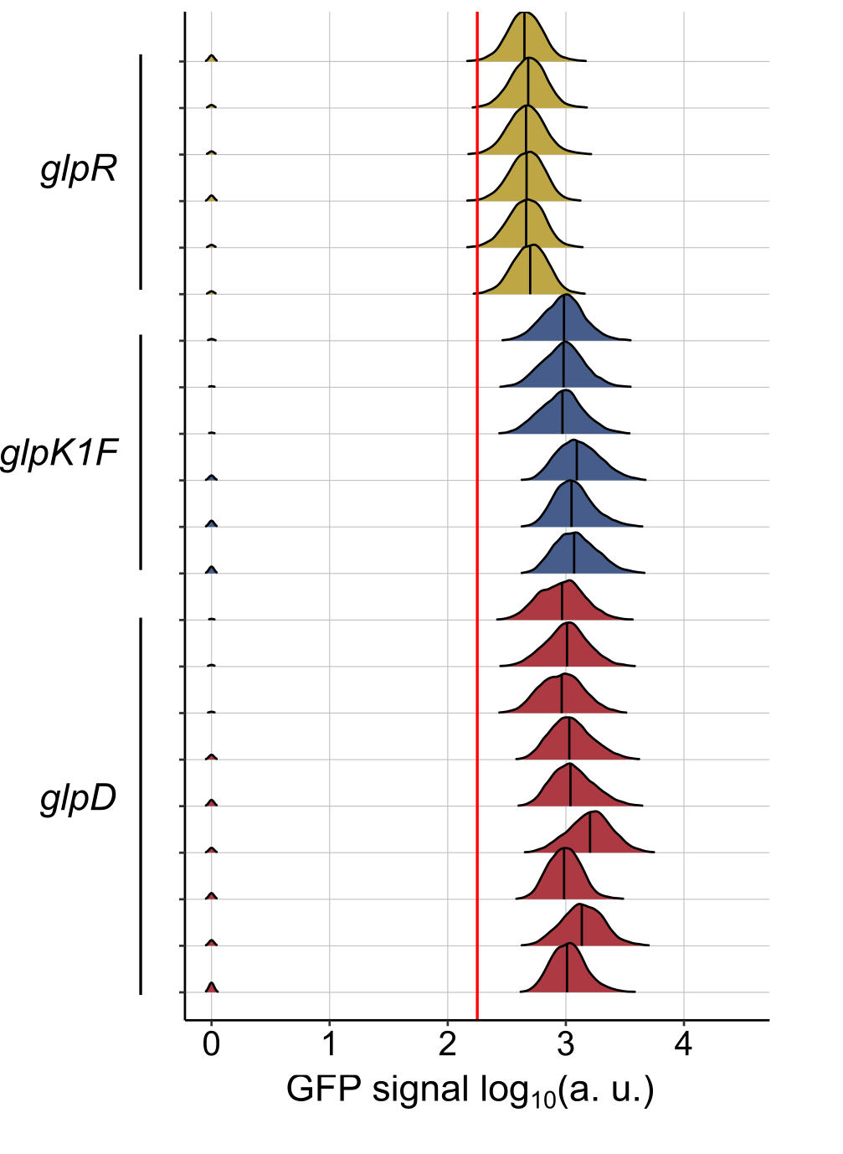
Transcriptional variation measured via flow cytometry
Promoter activity
Gene specific expression distribution
Notes:
We analyzed the promoter activity by using flow cytometry
Resulting signal intensity distribution for each sample representing a population is plotted on the right
(medians are indicated by a vertical line)
glpR promoter: stable signal
glpKF gene share a promoter: signal slightly shifted for some replicates
glpD: whole population shifted between the different replicates, even though the distribution for these replicates looks very similar.
For some replicates the distribution even looks a bit wider
This behavior perfectly reflects the variable bimodal distribution shown in the transcriptome dataset
12:00

Slide 4
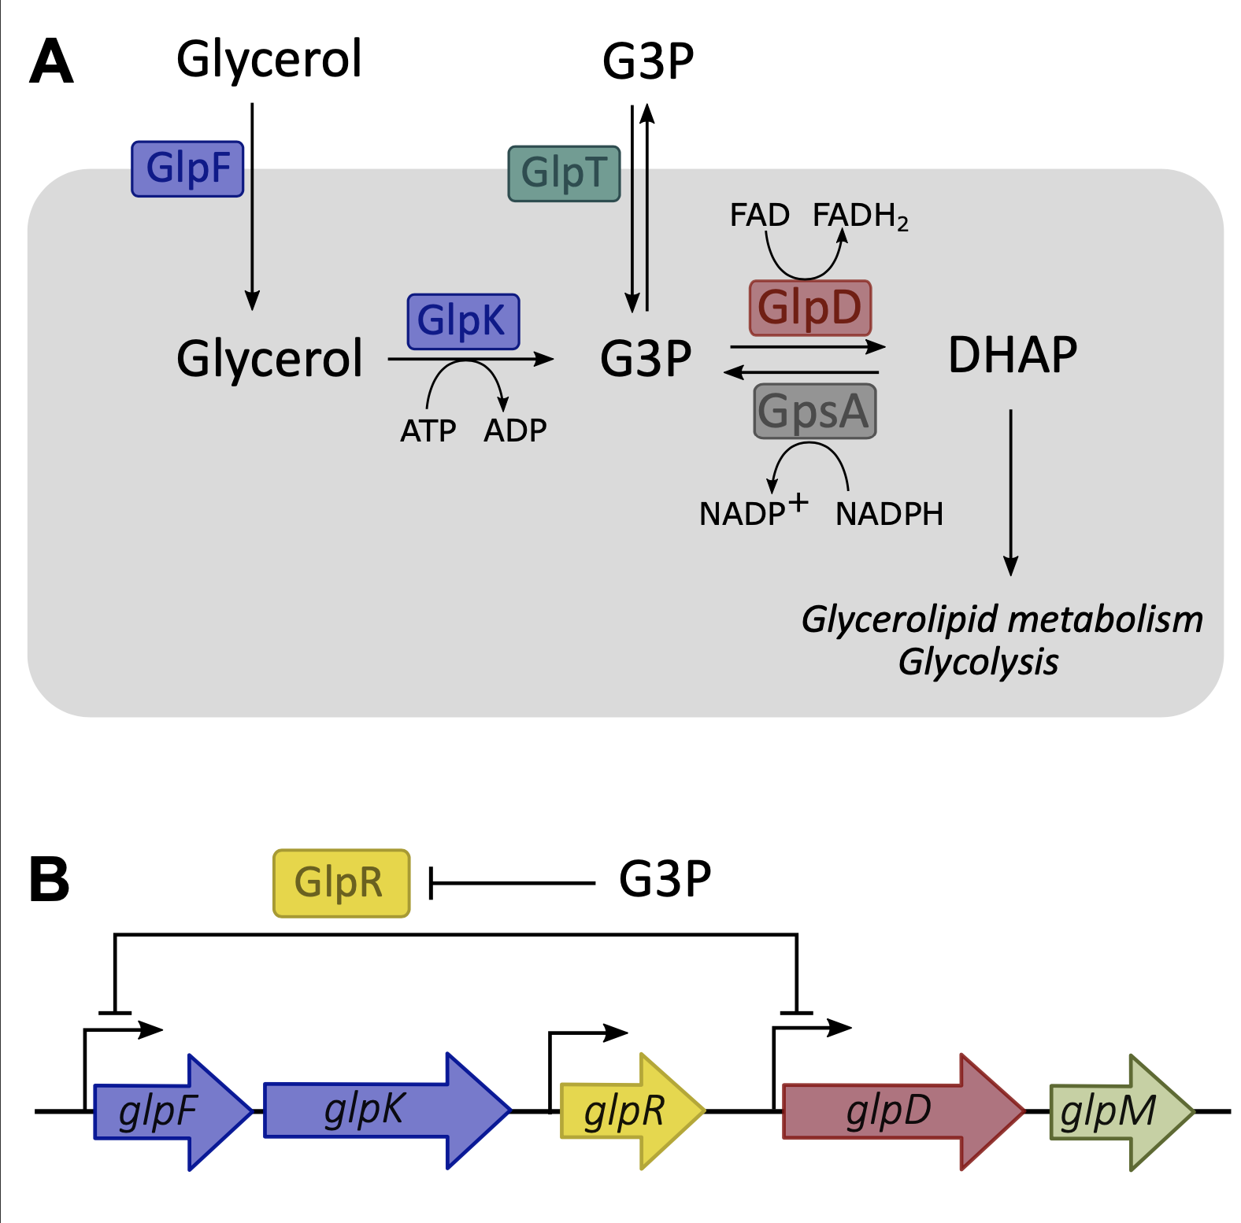
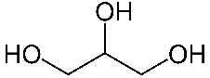
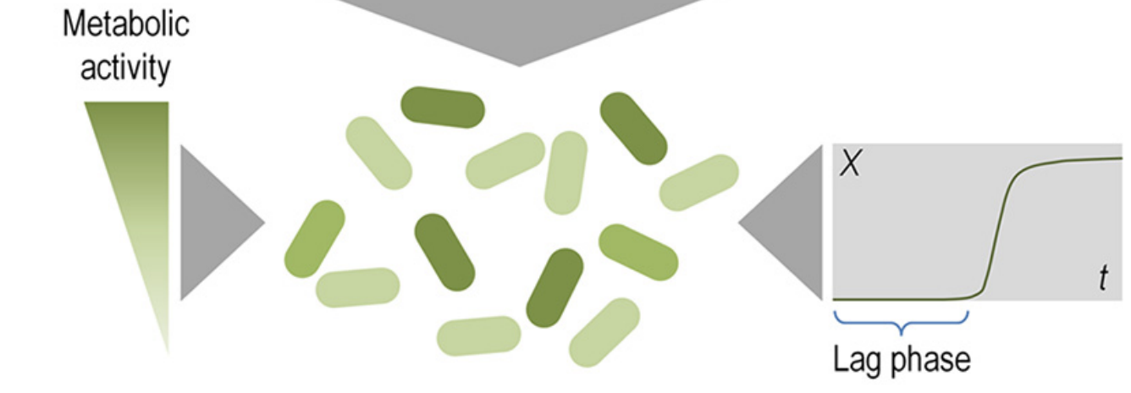
Glycerol metabolism in P. aeruginosa
P. putida:
G3P: glycerol-3-phosphate
DHAP: dihydroxyacetone phosphate
Nikel, Pablo I., et al. "The glycerol-dependent metabolic persistence of Pseudomonas putida KT2440 reflects the regulatory logic of the GlpR repressor." MBio 6.2 (2015).
Notes:
To this end: we need a closer look on what is known on the regulation of glycerol metabolism….
Explain!...
expression of glpD and glpKF are both negatively controlled at the same time via GlpR, the regulon repressor
Default state of the operon is OFF
In order to lift the repression, there needs to be an inactivation of the repressor by G3P, which can be metabolized from glycerol, however this only works if the GlpR repressor is stochastically lifted
This stochastic regulation of GlpR repression was analysed in P. putida:
In this study, the authors showed that this repression leads to a time dependent bimodal switch of metabolically active and inactive bacteria, resulting in a bimodal distribution
The repression of the regulon could only be overcome randomly when G3P is available at the same time
Thus GlpR is inactivated which results in a positive feedback loop and therefore derepression and maximized glpD operon transcription
In order to analyze this behavior on single cell level in P. aeruginosa, we performed time-lapse microscopy with the glpD promoter reporting strain
15:31

Slide 5
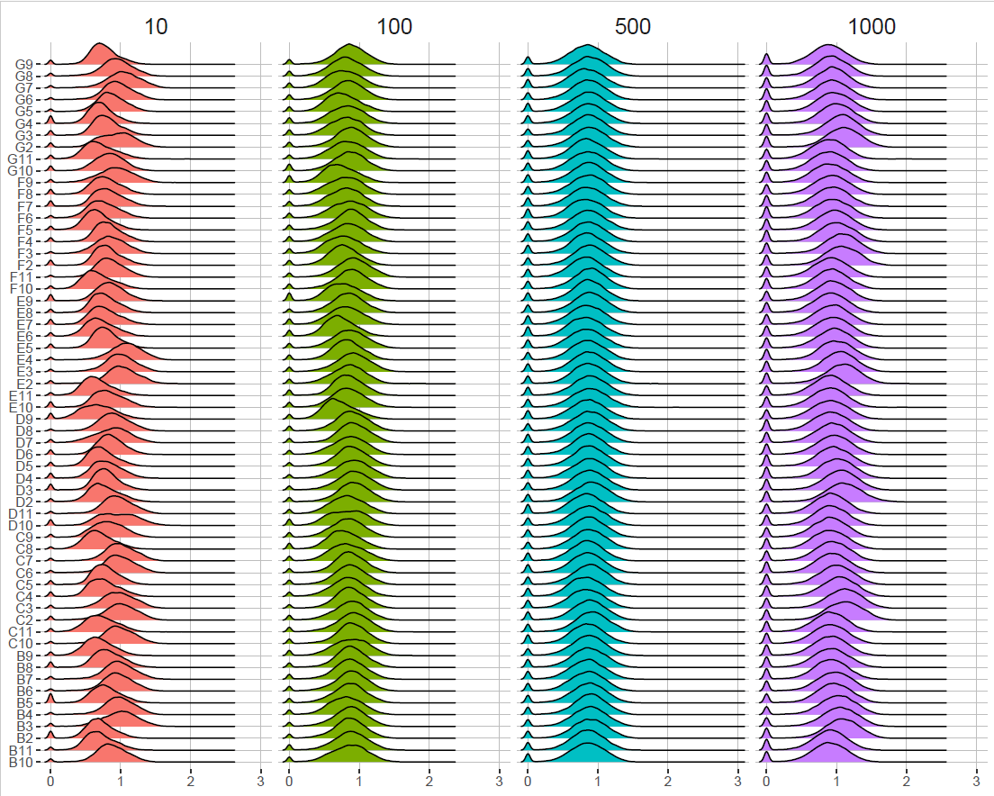
Highly replicated FACS analysis in LB medium
Inoculation size (Cell count)
Fluorescence intensity reflecting glpD promoter activity

Slide 6
Hysteresis Experiment
OD600 after switch to LB

Slide 7
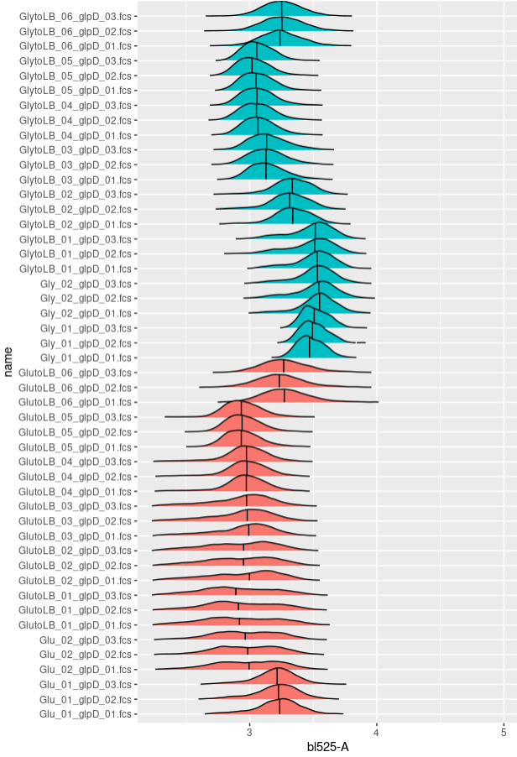
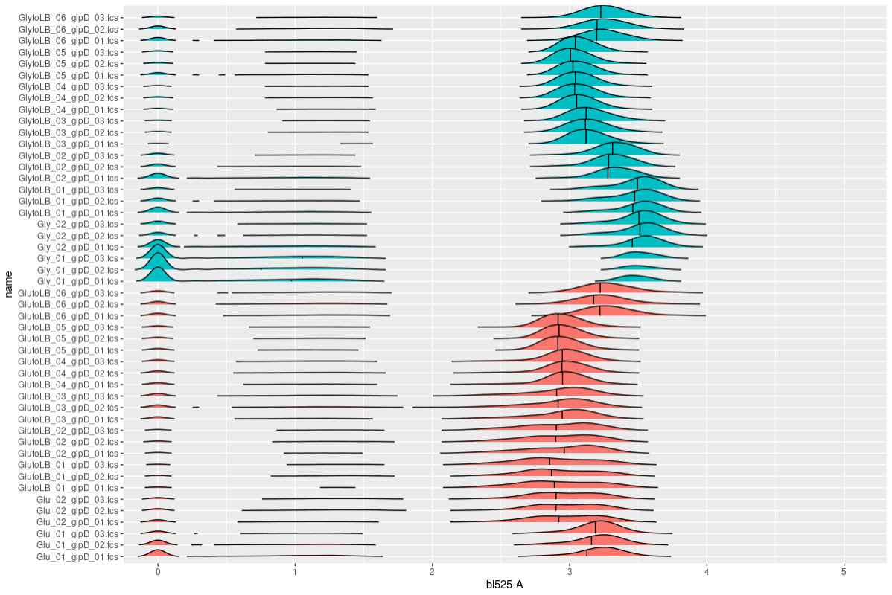
FACS results, gated for GFP
Hysteresis Experiment
FACS results, ungated for GFP

Slide 8
Hysteresis Experiment Nr.5
Changes:
An extra passage was added (however, not measured the first o/n culture on FACS, but OD)
Prior to switching the medium from Gly or glu to LB, the cells were centrifuged and the pellet resuspended in LB (light washing step)
OD600:

Slide 9
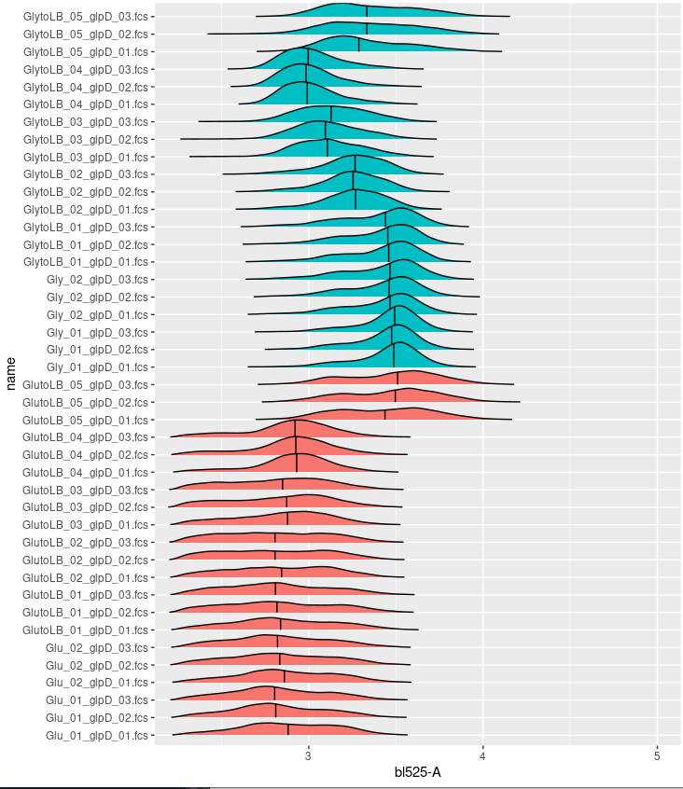
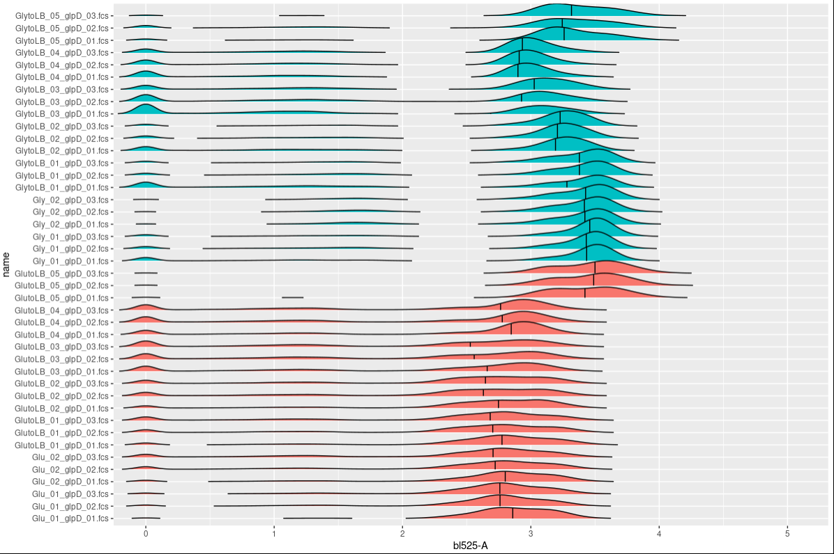
FACS results, gated for GFP
Hysteresis Experiment Nr.5
FACS results, ungated for GFP

Slide 10
EXPERIMENT 2
glpD activity in LB and LB + G3P: OD values at FACS measurement timepoint
10 Cells, LB + G3P |  |  | 1 | 2 | 3 | 4 | 5 | 6 | 7 | 8 | 9 | 10 | 11 | 12
 |  | A
 |  | B |  | 0.5 | 0.439 | 0.388 | 0.396 | 0.396 | 0.4 | 0.424 | 0.418 | 0.382 | 0.42
 |  | C |  | 0.443 | 0.411 | 0.39 | 0.382 | 0.387 | 0.37 | 0.376 | 0.375 | 0.344 | 0.418
 |  | D |  | 0.487 | 0.42 | 0.387 | 0.399 | 0.393 | 0.397 | 0.365 | 0.365 | 0.358 | 0.371
 |  | E |  | 0.479 | 0.411 | 0.367 | 0.358 | 0.377 | 0.386 | 0.357 | 0.357 | 0.384 | 0.38
 |  | F |  | 0.464 | 0.398 | 0.395 | 0.359 | 0.356 | 0.355 | 0.359 | 0.383 | 0.346 | 0.351
 |  | G |  | 0.401 | 0.382 | 0.365 | 0.355 | 0.383 | 0.333 | 0.333 | 0.344 | 0.376 | 0.339
 |  | H
10 cells, LB only |  | A
 |  | B |  | 0.325 | 0.148 | 0.133 | 0.128 | 0.158 | 0.167 | 0.115 | 0.154 | 0.148 | 0.112
 |  | C |  | 0.183 | 0.096 | 0.129 | 0.095 | 0.156 | 0.228 | 0.335 | 0.121 | 0.133 | 0.176
 |  | D |  | 0.1 | 0.122 | 0.113 | 0.223 | 0.055 | 0.334 | 0.109 | 0.043 | 0.153 | 0.14
 |  | E |  | 0.114 | 0.095 | 0.169 | 0.044 | 0.365 | 0.142 | 0.226 | 0.129 | 0.122 | 0.169
 |  | F |  | 0.17 | 0.345 | 0.264 | 0.137 | 0.152 | 0.152 | 0.375 | 0.356 | 0.106 | 0.046
 |  | G |  | 0.119 | 0.273 | 0.084 | 0.104 | 0.263 | 0.042 | 0.148 | 0.208 | 0.087 | 0.136
 |  | H
100 Cells, LB + G3P |  | A
 |  | B |  | 0.471 | 0.558 | 0.611 | 0.639 | 0.655 | 0.682 | 0.681 | 0.665 | 0.622 | 0.568
 |  | C |  | 0.391 | 0.515 | 0.51 | 0.554 | 0.609 | 0.672 | 0.662 | 0.644 | 0.644 | 0.618
 |  | D |  | 0.473 | 0.499 | 0.455 | 0.531 | 0.582 | 0.617 | 0.633 | 0.62 | 0.659 | 0.6
 |  | E |  | 0.49 | 0.451 | 0.464 | 0.571 | 0.612 | 0.604 | 0.628 | 0.623 | 0.619 | 0.621
 |  | F |  | 0.482 | 0.43 | 0.498 | 0.542 | 0.658 | 0.611 | 0.608 | 0.635 | 0.618 | 0.592
 |  | G |  | 0.466 | 0.537 | 0.526 | 0.555 | 0.58 | 0.609 | 0.599 | 0.596 | 0.594 | 0.588
 |  | H
100 cells, LB only |  | A
 |  | B |  | 0.297 | 0.285 | 0.28 | 0.356 | 0.306 | 0.242 | 0.229 | 0.322 | 0.341 | 0.289
 |  | C |  | 0.207 | 0.2 | 0.25 | 0.261 | 0.237 | 0.256 | 0.237 | 0.318 | 0.258 | 0.206
 |  | D |  | 0.309 | 0.306 | 0.276 | 0.212 | 0.276 | 0.24 | 0.291 | 0.188 | 0.187 | 0.208
 |  | E |  | 0.276 | 0.23 | 0.217 | 0.193 | 0.256 | 0.314 | 0.26 | 0.184 | 0.239 | 0.268
 |  | F |  | 0.287 | 0.215 | 0.278 | 0.184 | 0.273 | 0.232 | 0.248 | 0.248 | 0.295 | 0.309
 |  | G |  | 0.293 | 0.224 | 0.281 | 0.222 | 0.245 | 0.215 | 0.283 | 0.255 | 0.319 | 0.252

Slide 11
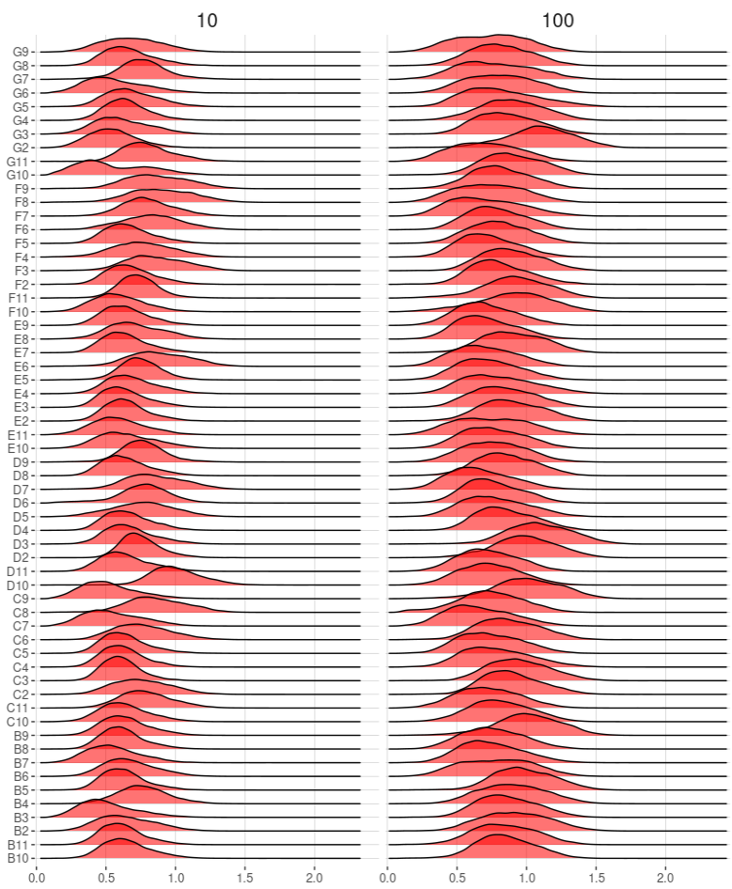
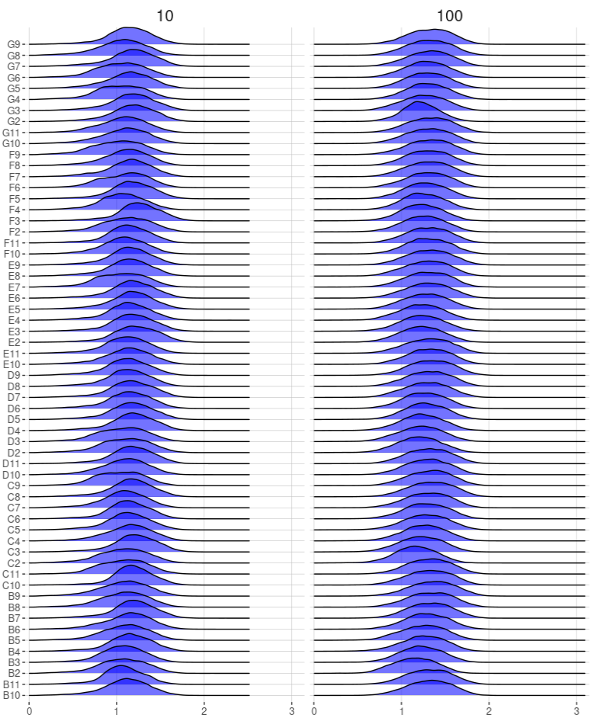
glpD activity in LB and LB + G3P: FACS results
LB-medium only
LB + G3P 90mM
Inoculum (number of cells)

Slide 12
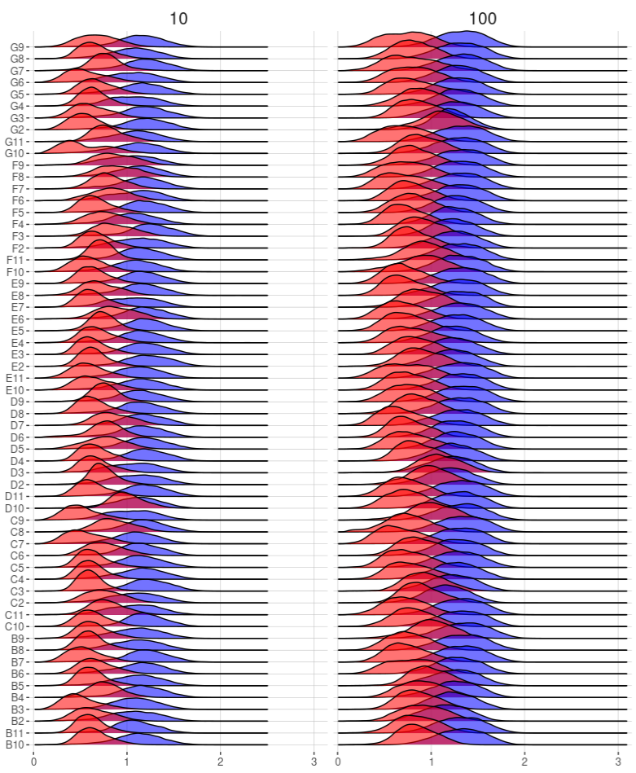
Same as before in one graphic
Red = LB
Blue = LB + G3P

Slide 13
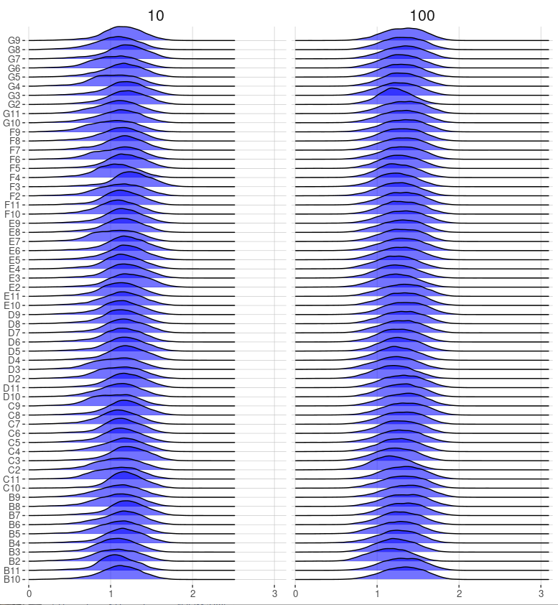
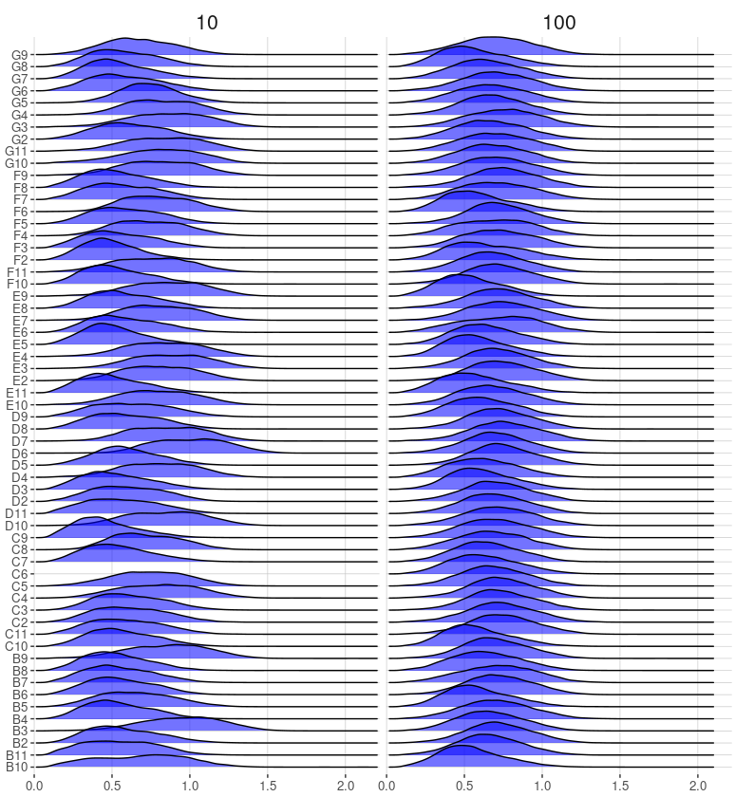
LB – G3P Experiment Nr. 2 (Noise)
Gated LB + G3P
Gated LB only

Slide 14
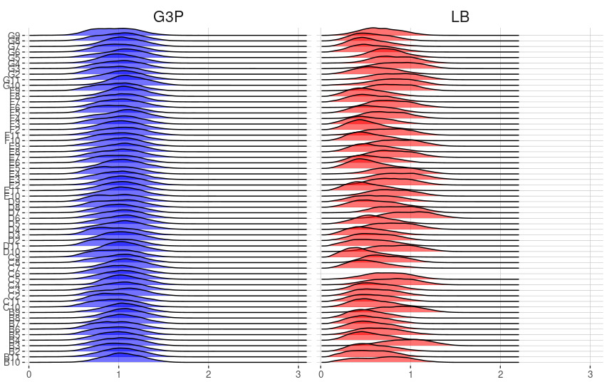
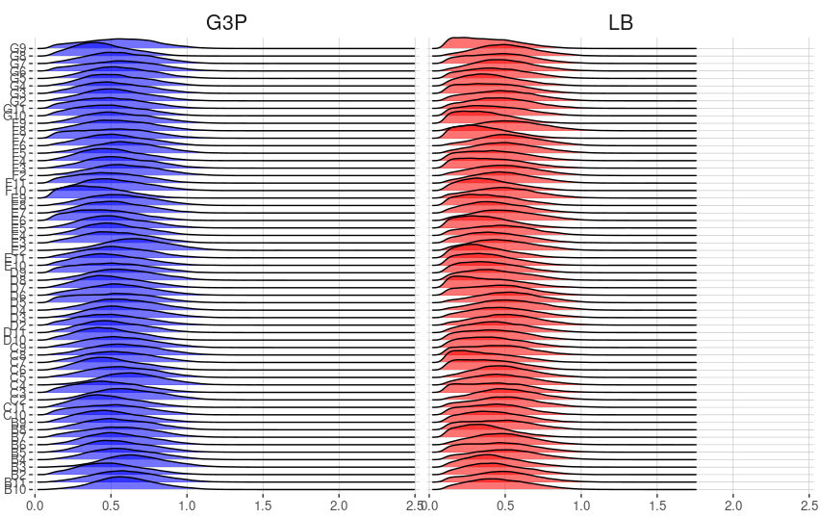
glpD in LB + G3P and LB only, 10 cells inoculum
uvrA in LB + G3P and LB only, 10 cells inoculum

